Slide 1



Data Types and Variables
Types of Operators
SoftUni Team
Technical Trainers
Software University
https://softuni.bg

Slide 2
Table of Contents
What is data type
Strings
Numbers
Booleans
Additional Data Types
2

Slide 3
Have a Question?
sli.do
#fund-python

Slide 4
What is Data Type
Definition and Examples

Slide 5
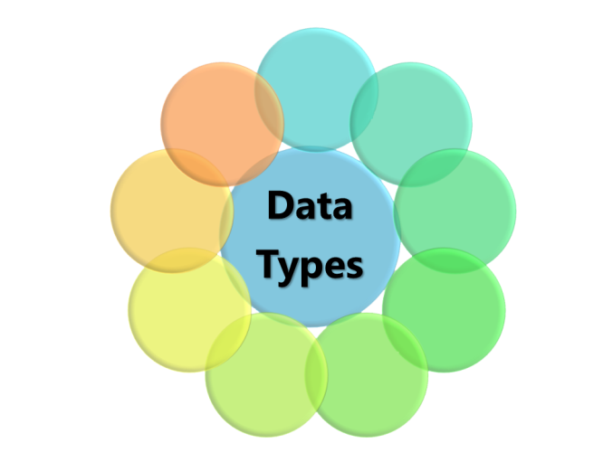
What is Data Type?
A classification that specifies which type of value a variable has and what type of operations can be applied to it
In Python we have the following data types:
Numeric Types: int, float, complex, decimal
Text Type: str
List, Set, Tuple, Dictionary
Boolean
5

Slide 6
Examples
int_num = 10 # int value
float_num = 10.2 # float value
a_str = 'Hello world' # str value
is_true = True # bool value
list = [123, 'abcd', 10.2, 'd'] # list
dict = {'name': 'Amy', 'age': 10} # dictionary

Slide 7
Data Types Are Dynamic
Python is a dynamic language
Variables are not directly associated with any particular value type
Any variable can be assigned (and re-assigned) values of all types
variable = 42 # variable is now an int
variable = 'bar' # variable is now a string
variable = True # variable is now a boolean

Slide 8
Check the Type of a Variable
The type() function helps you find the type of the variable
The isinstance() function checks if the specified object is of the specified type
print(type('123')) # <class 'str'>
print(type(123)) # <class 'int'>
print(type(123==123)) # <class 'bool'>
print(isinstance('123', str)) # True
print(isinstance(123, str)) # False
print(isinstance(123==123, bool)) # True

Slide 9
Strings
'ABC'
Sequence of Characters

Slide 10
What is a String?
Used to represent textual data
Each element in the String occupies a position in the String
The first element is at index 0, the next at index 1, and so on
The length of a String is the number of elements in it
name = 'George'
print(name[0]) #'G'
Accessing element at index
10

Slide 11
String Literal
String literals in Python are surrounded by either single quotation marks or double quotation marks:
'hello' is the same as "hello"
The len() method returns the length of a string
a = "Hello, World!"
print(len(a)) # 13
11

Slide 12

Strings Are Immutable
Unlike in languages like C, Python strings are immutable
This means that once a string is created, it is not possible to modify it
name = 'George'
name[0] = 'P' # Error
12

Slide 13
String Interpolation
From Python 3.6+ we can use string interpolation
These are string literals that allow embedded expressions
name = 'Rick'
age = 18
print(f'{name} = {age}') # Rick = 18
Place your variables inside {}
13

Slide 14
Problem: Concatenate Names
Receive two names as string parameters and a delimiter
Print the names joined by the delimiter
John
Smith
->
Jan
White
<->
John->Smith
Jan<->White
first_name = input()
second_name = input()
delimiter = input()
print(f'{first_name}{delimiter}{second_name}')

Slide 15
Numbers
123
Integer, Float

Slide 16
Integer
Int or integer is a whole number, positive or negative, without decimals, of unlimited length
Python integers are immutable
x = 1 # int
y = 231223423352 # int
z = -2312312 # int
16

Slide 17
Float
Float is a floating-point real number, positive or negative, written with a decimal point dividing the integer and fractional parts, of unlimited length
Python floats are immutable
x = 1.1 # float
y = 231223423352.24 # float
z = -2312312.689 # float
17

Slide 18
Problem: Meters to Kilometers
Write a program that converts meters to kilometers formatted to the second decimal point.
1852
1.85
798
0.80
Notes:
Solution goes to note

Slide 19
Solution: Meters to Kilometers
meters = int(input())
kilometers = meters/1000
print(f'{kilometers:.2f}')

Slide 20
Problem: Pounds to Dollars
Write a program which converts British pounds to US dollars formatted to the 3rd decimal point
1 British Pound = 1.31 Dollars
80
104.800
39
51.090
Notes:
Solution goes to note

Slide 21
Solution: Pounds to Dollars
pounds = int(input())
dollars = pounds * 1.31
print(f'{dollars:.3f}')

Slide 22
Problem: Centuries to Minutes
Write a program to enter an integer number of centuries and convert it to years, days, hours and minutes
Centuries = 1
1 centuries = 100 years = 36524 days = 876576 hours = 52594560 minutes

Slide 23
Solution: Centuries to Minutes
centuries = int(input())
years = centuries * 100
days = int(years * 365.2422)
hours = 24 * days
minutes = 60 * hours
print(f"{centuries} centuries = {years} years = {days} days = {hours} hours = {minutes} minutes")
Tropical year has 365.2422 days
(int) converts float to int
23

Slide 24
Booleans
True False
Conditions

Slide 25
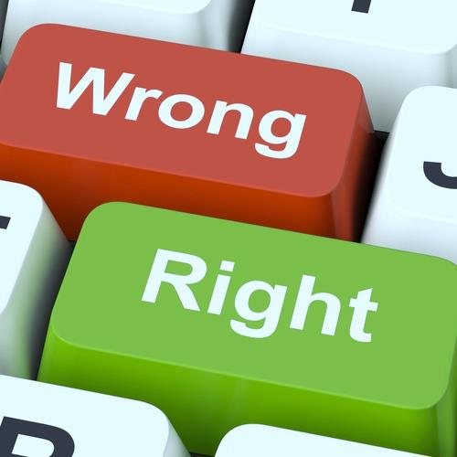
What is a Boolean?
Boolean represents a logical entity and can have two values: True and False
You can use the bool() function to find out if an expression (or a variable) is true:
Or even easier:
print(bool(10 > 9)) # True
print(10 > 9) # True
25

Slide 26
Comparisons and Conditions
Operator | Description | Example
== | equal | if (day == 'Monday')
> | greater than | if (salary > 9000)
< | less than | if (age < 18)
>= | greater than or equal | if (6 >= 6)
!= | not equal | if (5 != 5)
in | item is in sequence | 'a' in 'abc' # True

Slide 27
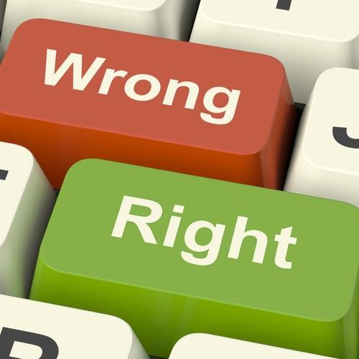
Booleans Examples (1)
Everything with a "value" is True
Everything without a "value" is False
number = 1
if (number):
print(number) # 1
True
number = None
if (number):
print(number)
else:
print('false') # False
False

Slide 28

Booleans Examples (2)
x = 0
bool(x) # False
x = -0
bool(x) # False
x = ''
bool(x) # False
x = False
bool(x) # False
x = None
bool(x) # False

Slide 29
Problem: Special Numbers
Write a program which reads an integer n. For all numbers in the range 1…n print the number and if it is special or not (True / False)
A number is special when the sum of its digits is 5, 7 or 11
1 -> False
2 -> False
3 -> False
4 -> False
5 -> True
6 -> False
7 -> True
8 -> False
9 -> False
10 -> False
11 -> False
12 -> False
13 -> False
14 -> True
15 -> False
16 -> True
17 -> False
18 -> False
19 -> False
20 -> False
20
Notes:
Solution goes to note

Slide 30
Solution: Special Numbers
n = int(input())
for num in range(1, n + 1):
sum_of_digits = 0
digits = num
while digits > 0:
sum_of_digits += digits % 10
digits = int(digits / 10)
# TODO: check whether the sum is special

Slide 31
Problem: Next Happy Year
Happy Year is the year with only distinct digits
for example, 2018
Write a program that receives an integer number and finds the next happy year
8989
9012
1001
1023
Notes:
Solution goes to note

Slide 32
Additional Datatypes
[] {}
List, Tuple, Set, Dict

Slide 33
Definition and Examples (1)
A list contains items separated by commas and enclosed within square brackets
A tuple is a collection which is ordered and unchangeable. In Python tuples are written with round brackets
cars = ["Saab", "Volvo", "BMW"]
example_tuple =("apple", "banana", "cherry") print(example_tuple)
33

Slide 34
Definition and Examples (2)
A set is a collection which is unordered and unindexed. Sets are written with curly brackets.
A dictionary is a collection which is ordered (python 3.7+), changeable and indexed
They have keys and values
example_set = {"apple", "banana", "cherry"}
print(example_set)
example_dict = {"brand": "Ford", "model": "Mustang"}
print(example_dict)
34

Slide 35
None Keyword
None

Slide 36
What is None?
The None keyword is used to define a null value or no value at all
There are two ways to check if a variable is None
One way can be performed by using the is keyword
Another is using the == syntax
if null_variable is None:
print('null_variable is None')
if null_variable == None:
print('null_variable is None')
36

Slide 37
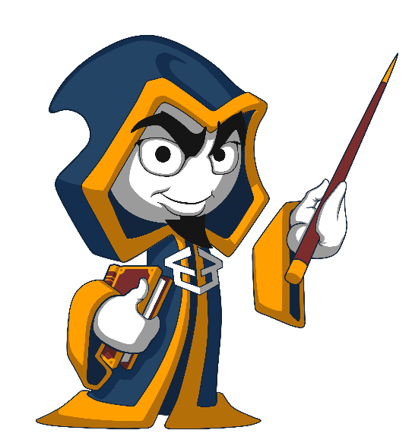
Summary
…
…
…
Python supports the following data types:
String
Bool
Int
Float
List, Tuple, Set, Dict
None is nothing

Slide 38
Questions?
Notes:
38

Slide 39












SoftUni Diamond Partners

Slide 40


Educational Partners

Slide 41

License
This course (slides, examples, demos, exercises, homework, documents, videos and other assets) is copyrighted content
Unauthorized copy, reproduction or use is illegal
© SoftUni – https://about.softuni.bg
© Software University – https://softuni.bg
Notes:
41

Slide 42
Trainings @ Software University (SoftUni)
Software University – High-Quality Education, Profession and Job for Software Developers
softuni.bg, softuni.org
Software University Foundation
softuni.foundation
Software University @ Facebook
facebook.com/SoftwareUniversity
Software University Forums
forum.softuni.bg
42
Notes:
42

